Slide 1
2024
Circle of Love
2024 Award Winners
Court #2690

Slide 2
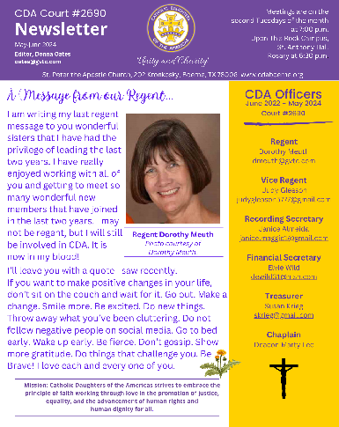
Education
Category V - 126+ Members
1st Place
Newsletter – Donna Oates

Slide 3
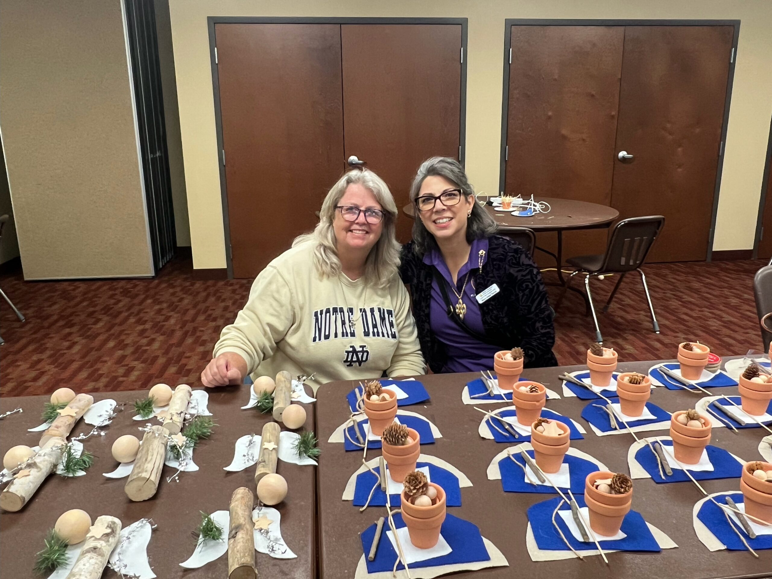
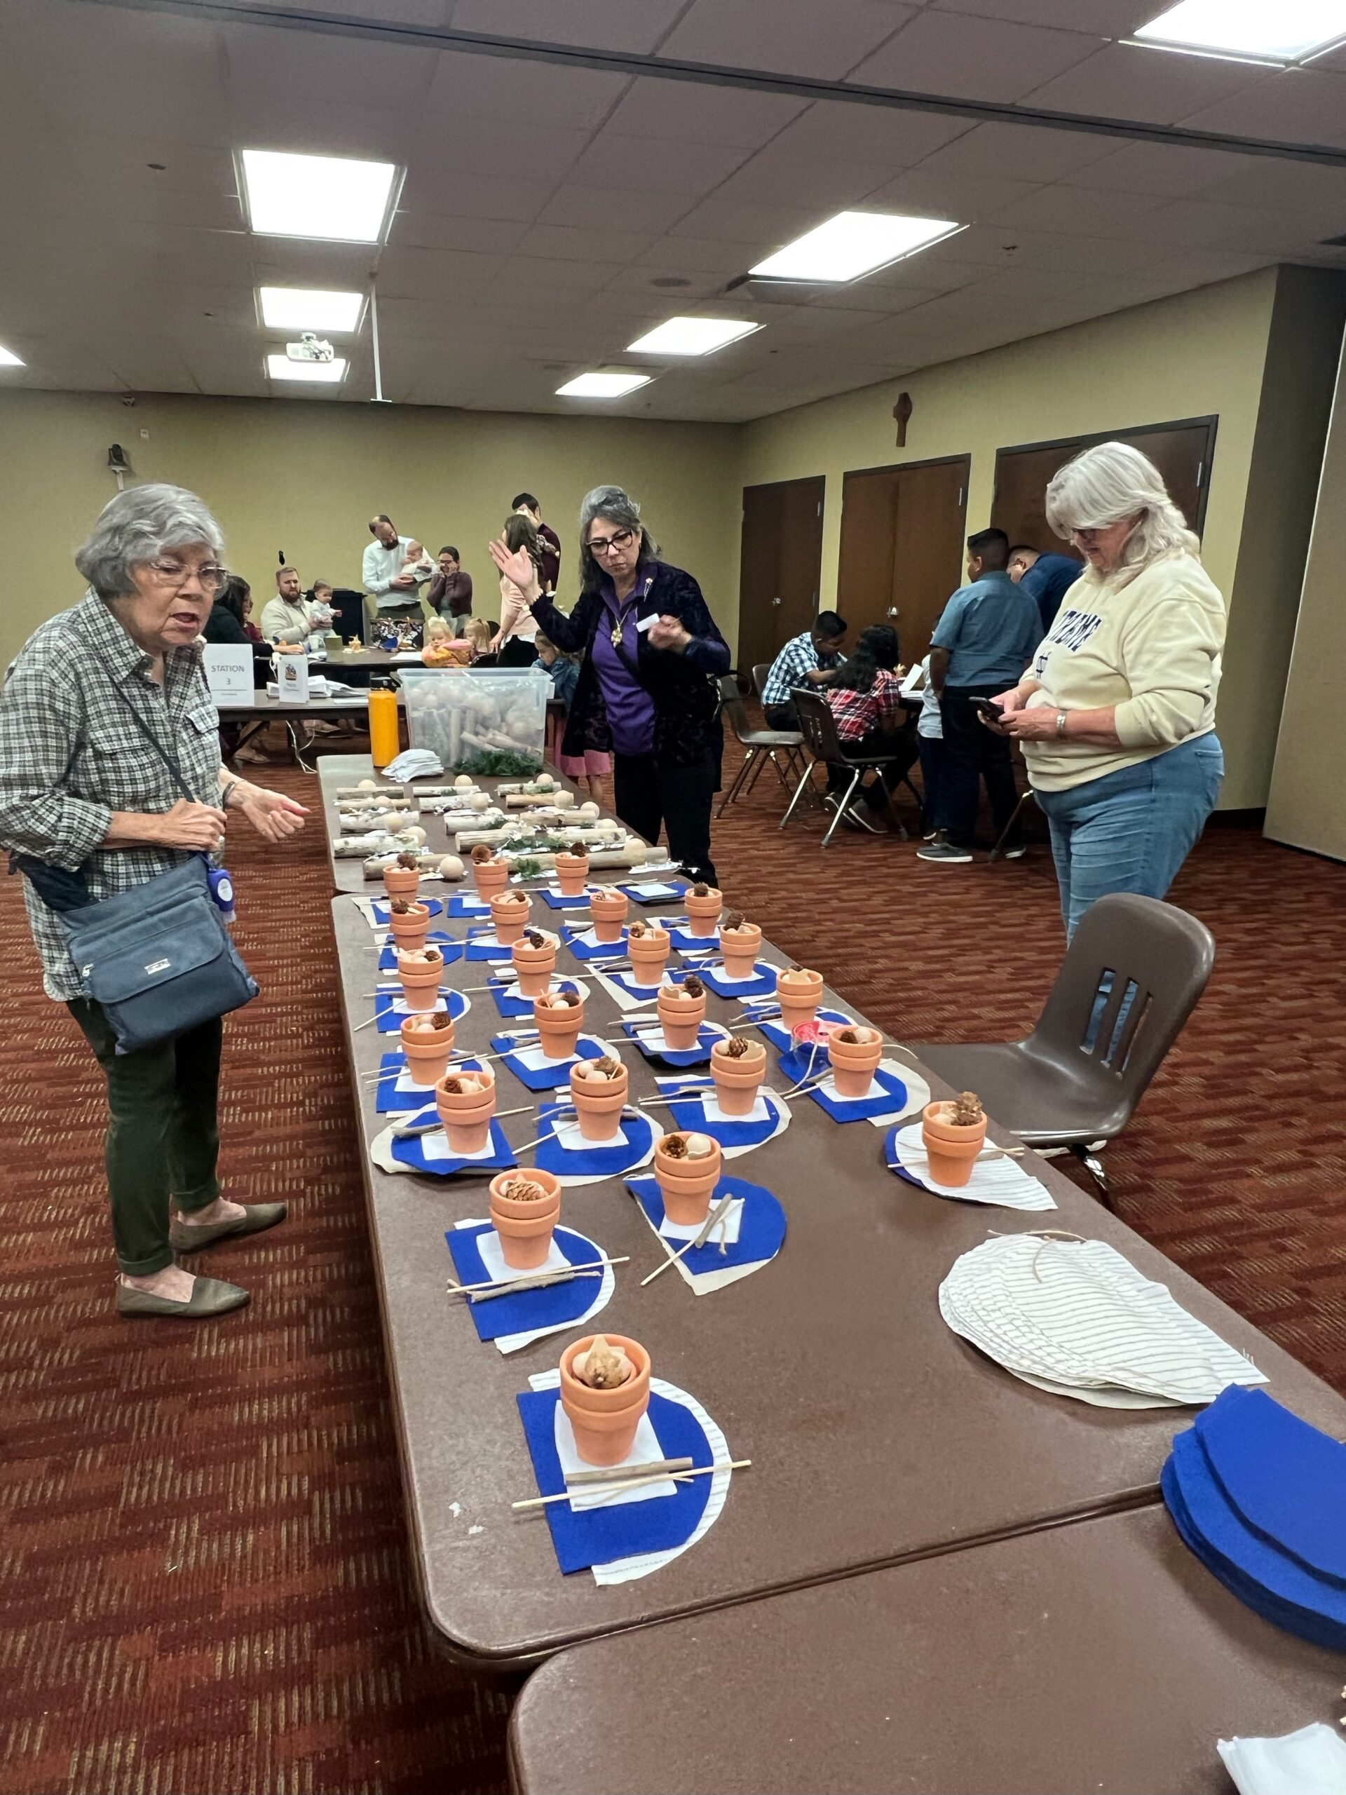
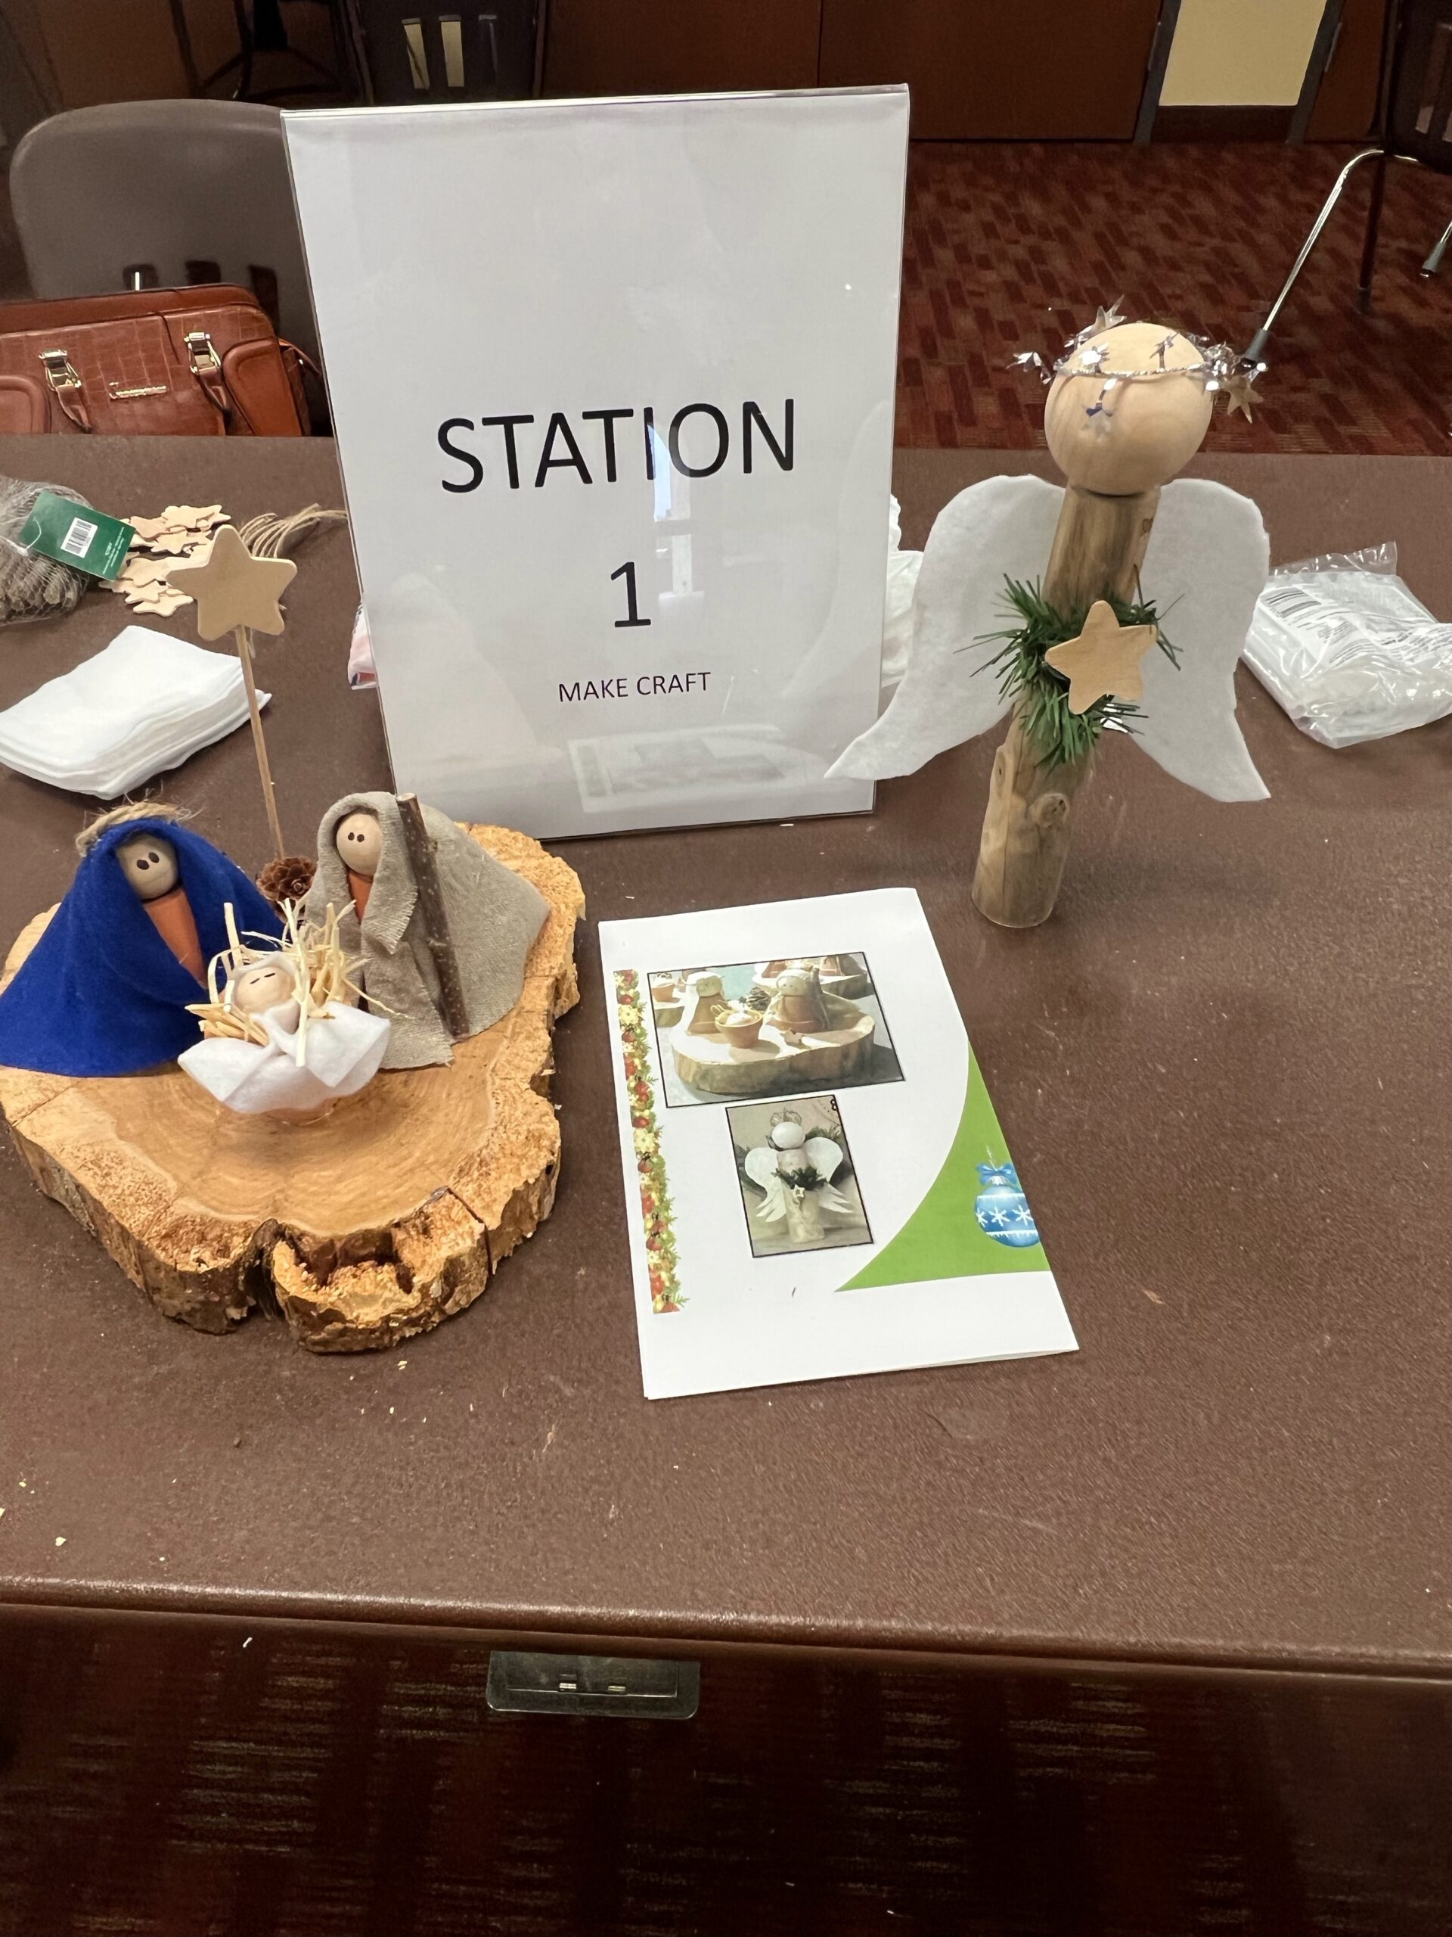
Family
Category V - 126+ Members
2nd Place
Family Advent Project – Michelle Lee

Slide 4
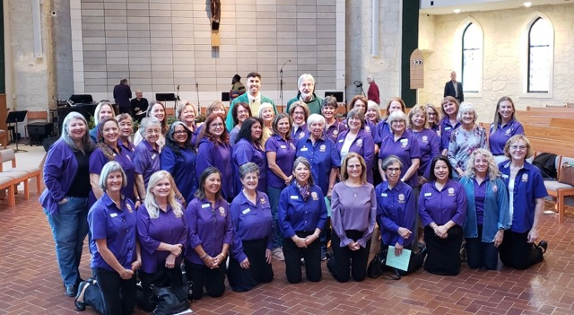
Leadership
Category V - 126+ Members
1st Place
ALL OF YOU – the leadership positions you serve within our parish

Slide 5
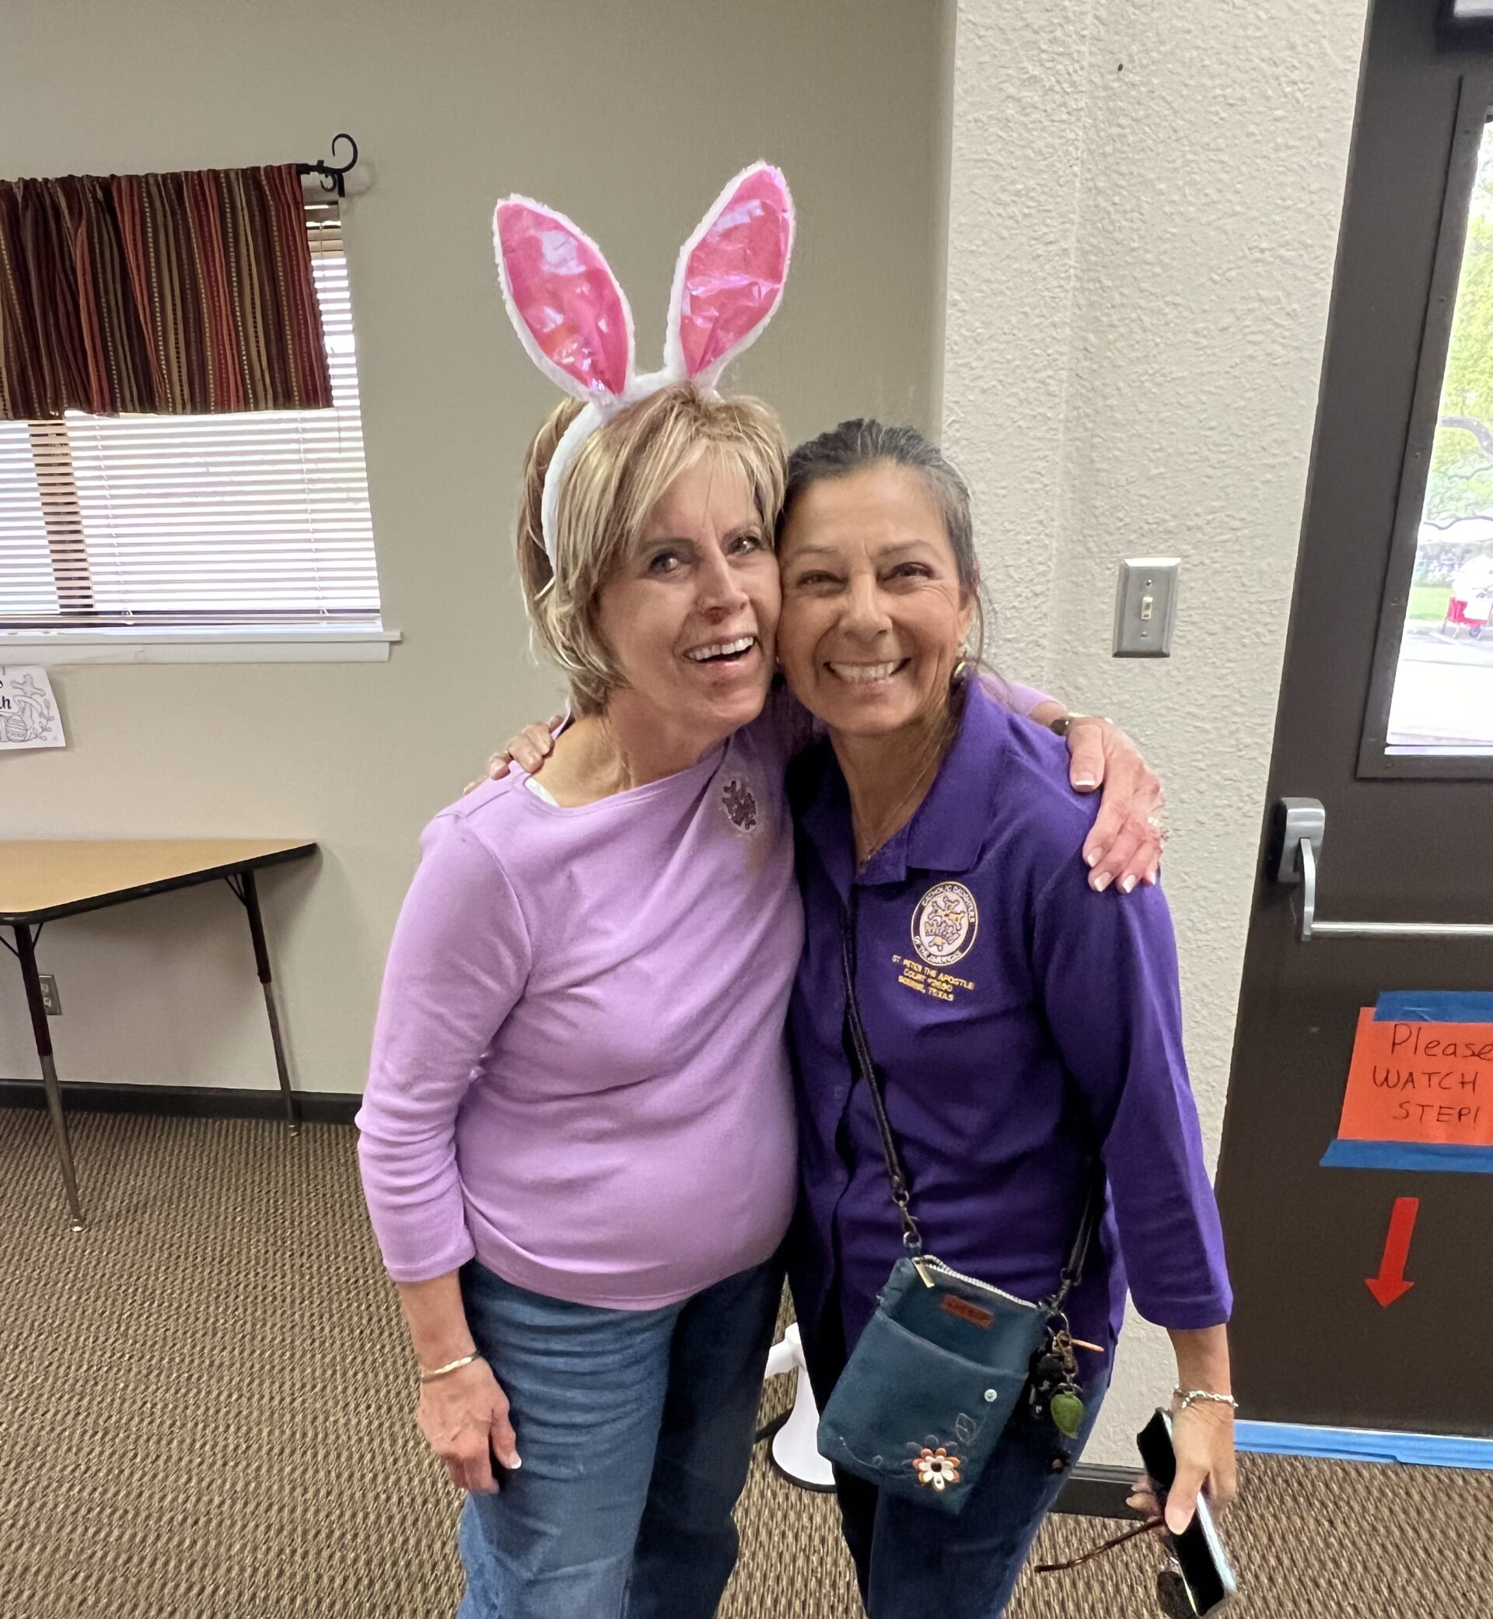
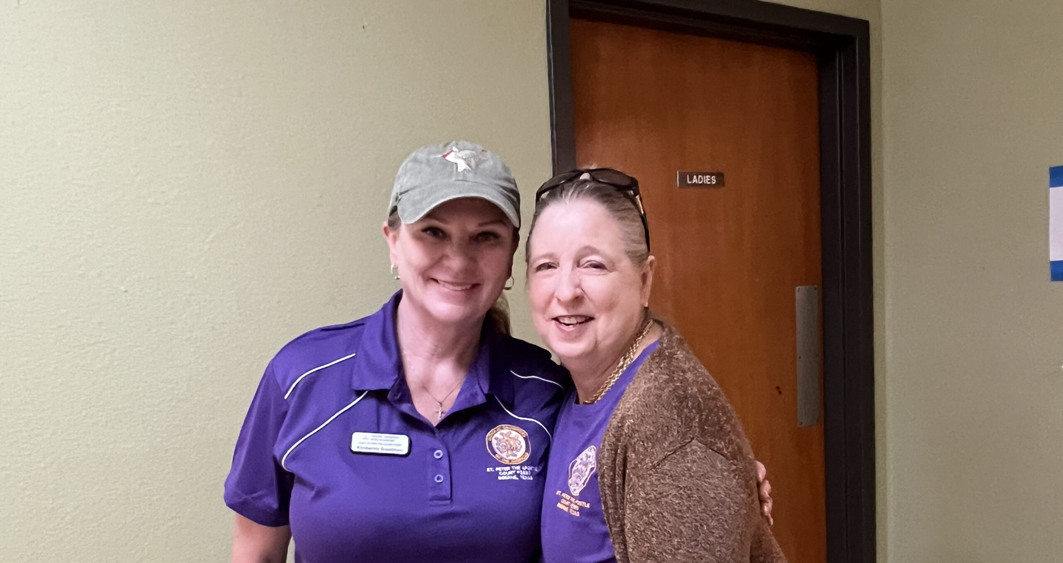
Leadership – it’s saying yes

Slide 6
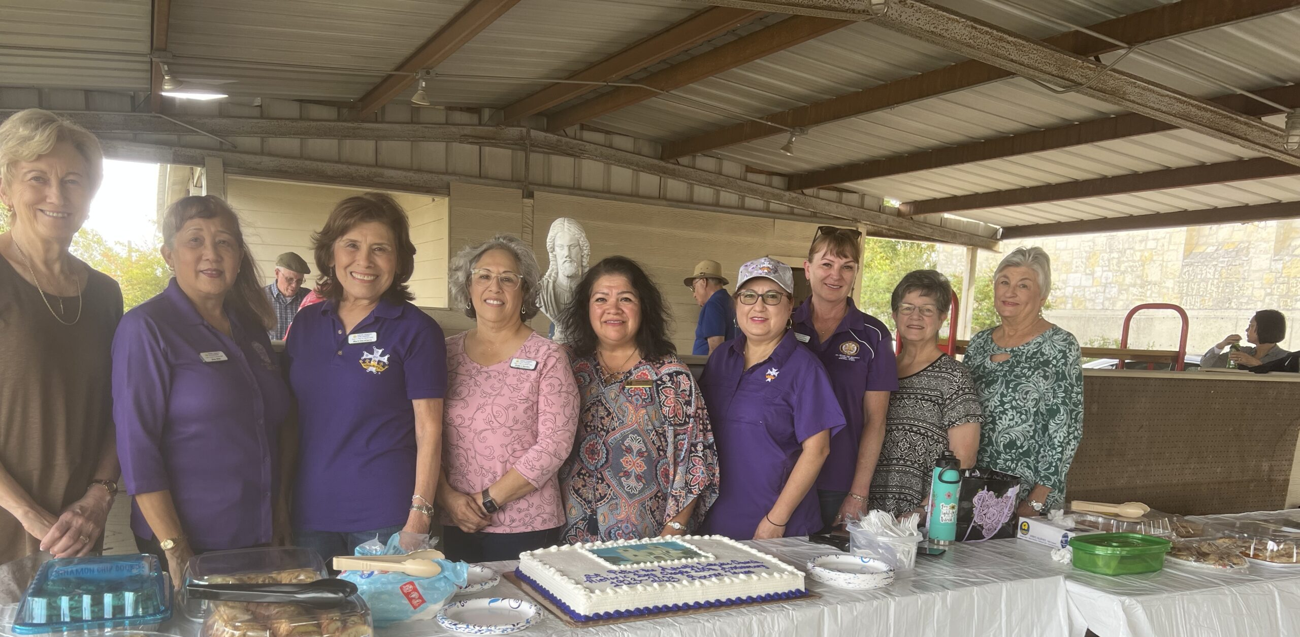
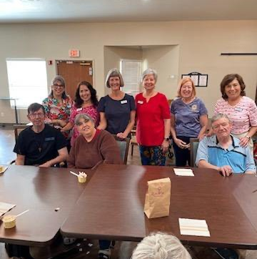
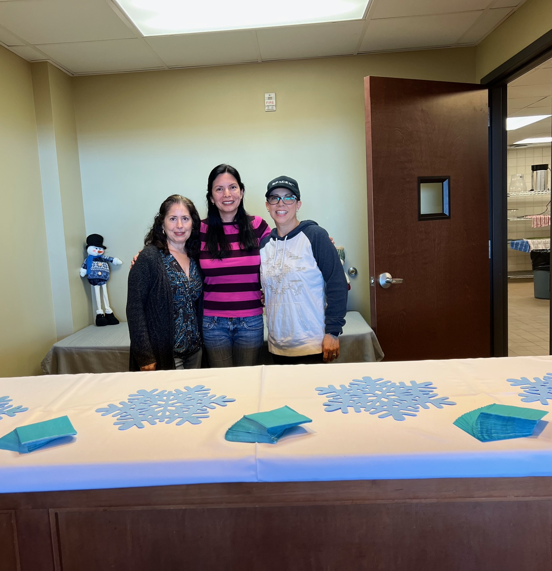
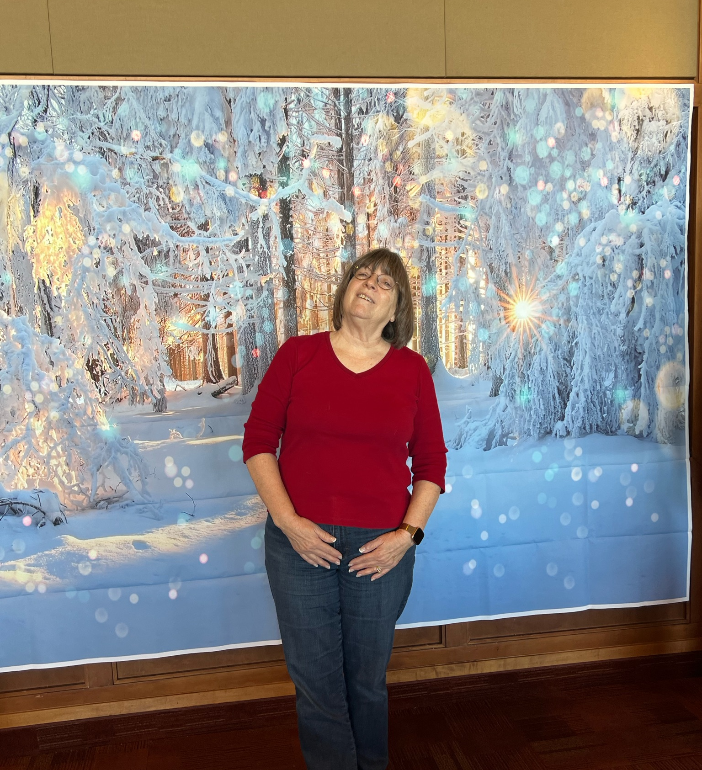
And serving side by side

Slide 7
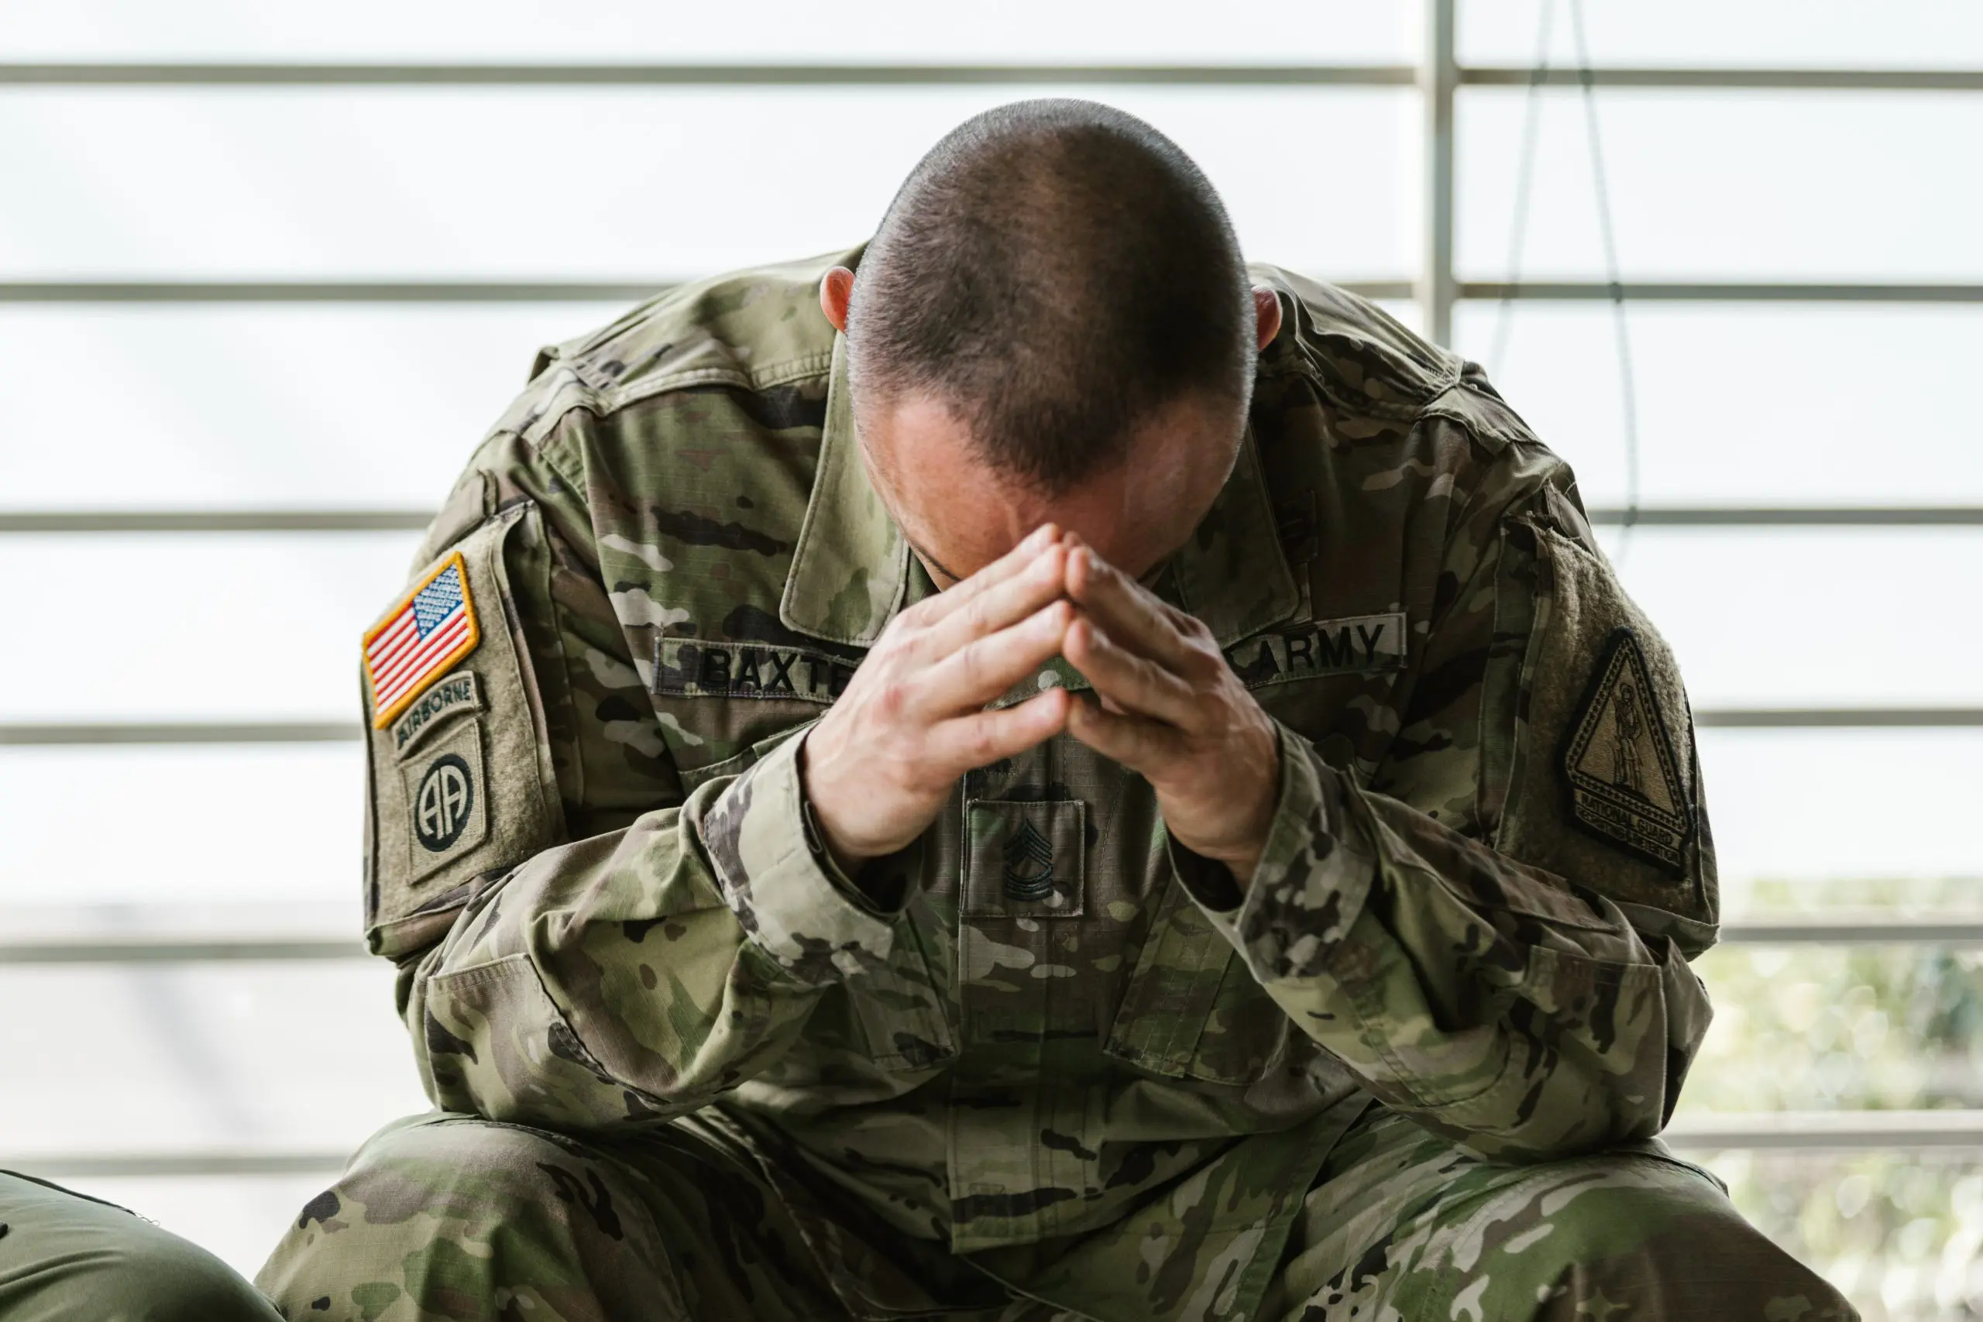
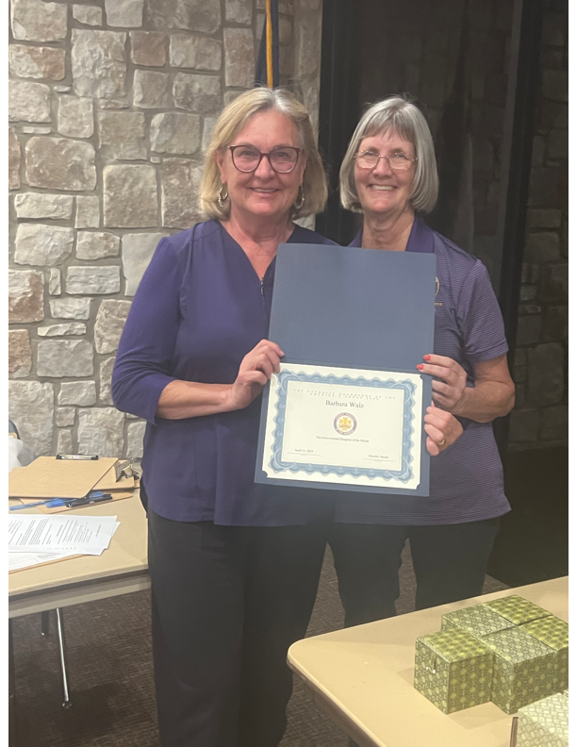
Legislation
Category V - 126+ Members
1st Place
Vet Program – Barbara Walz

Slide 8
Spiritual Enhancement
Category V - 126+ Members
1st Place
The Shroud – Judy Gleason

Slide 9
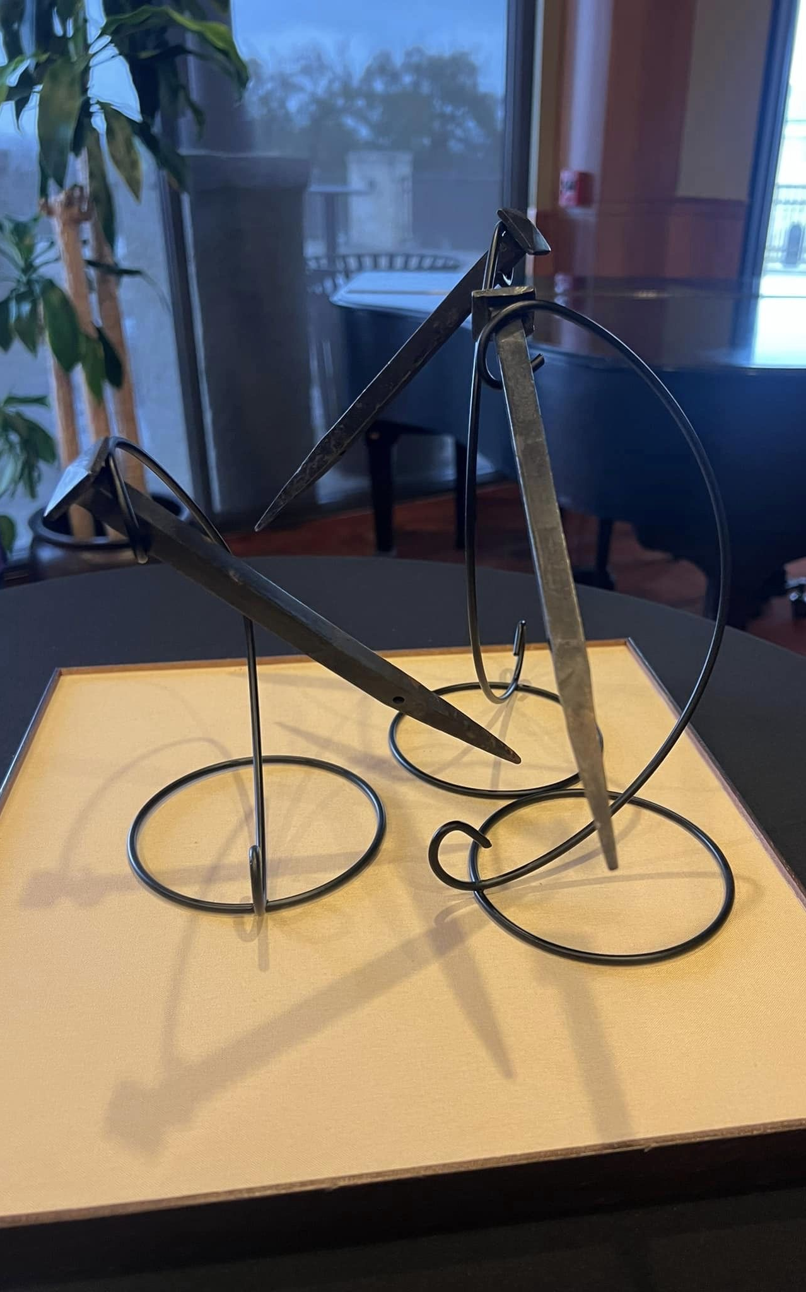
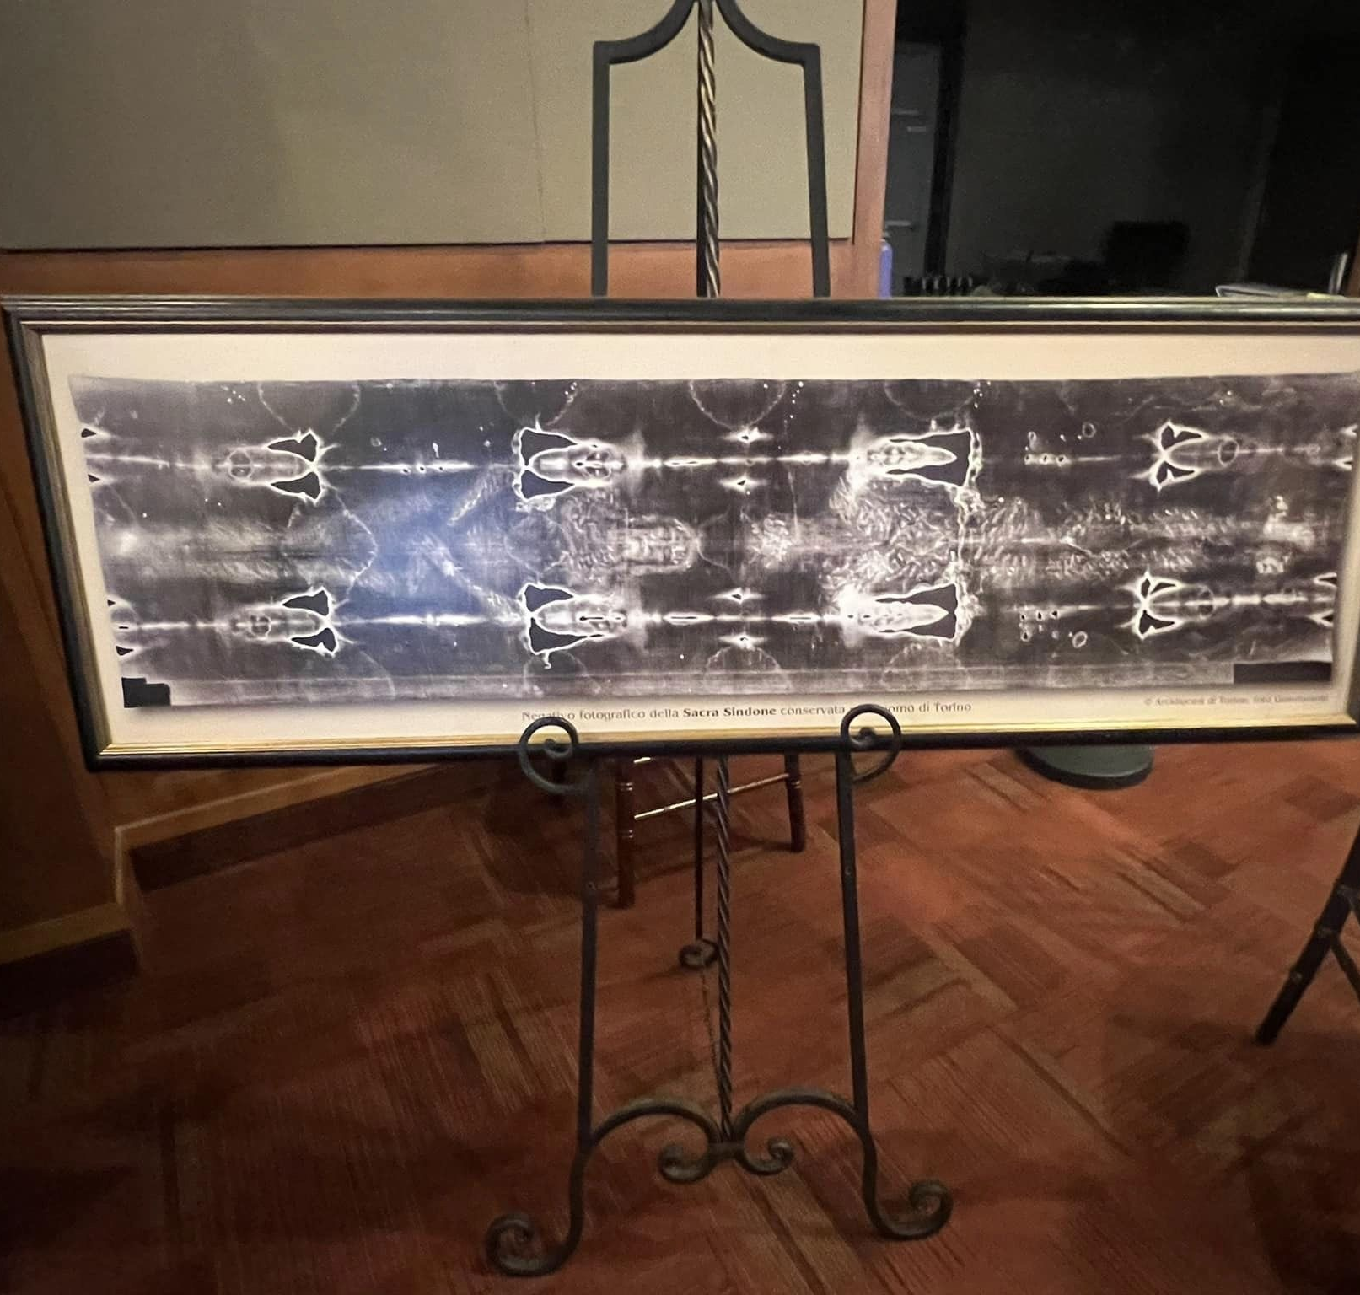
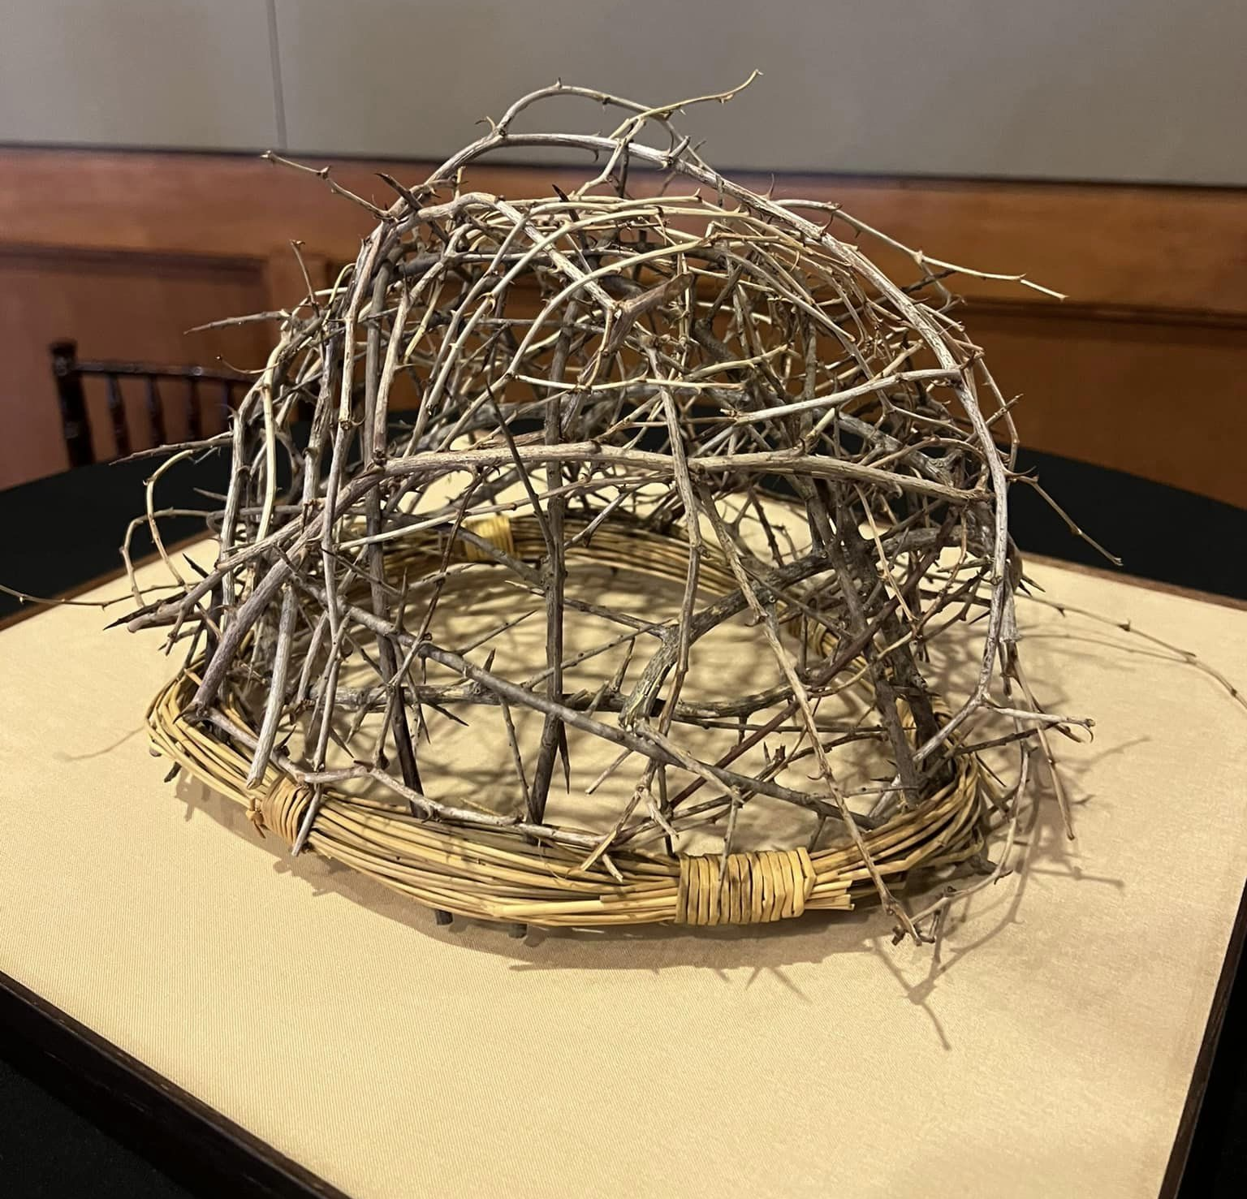
Were you there when they crucified our Lord?

Slide 10
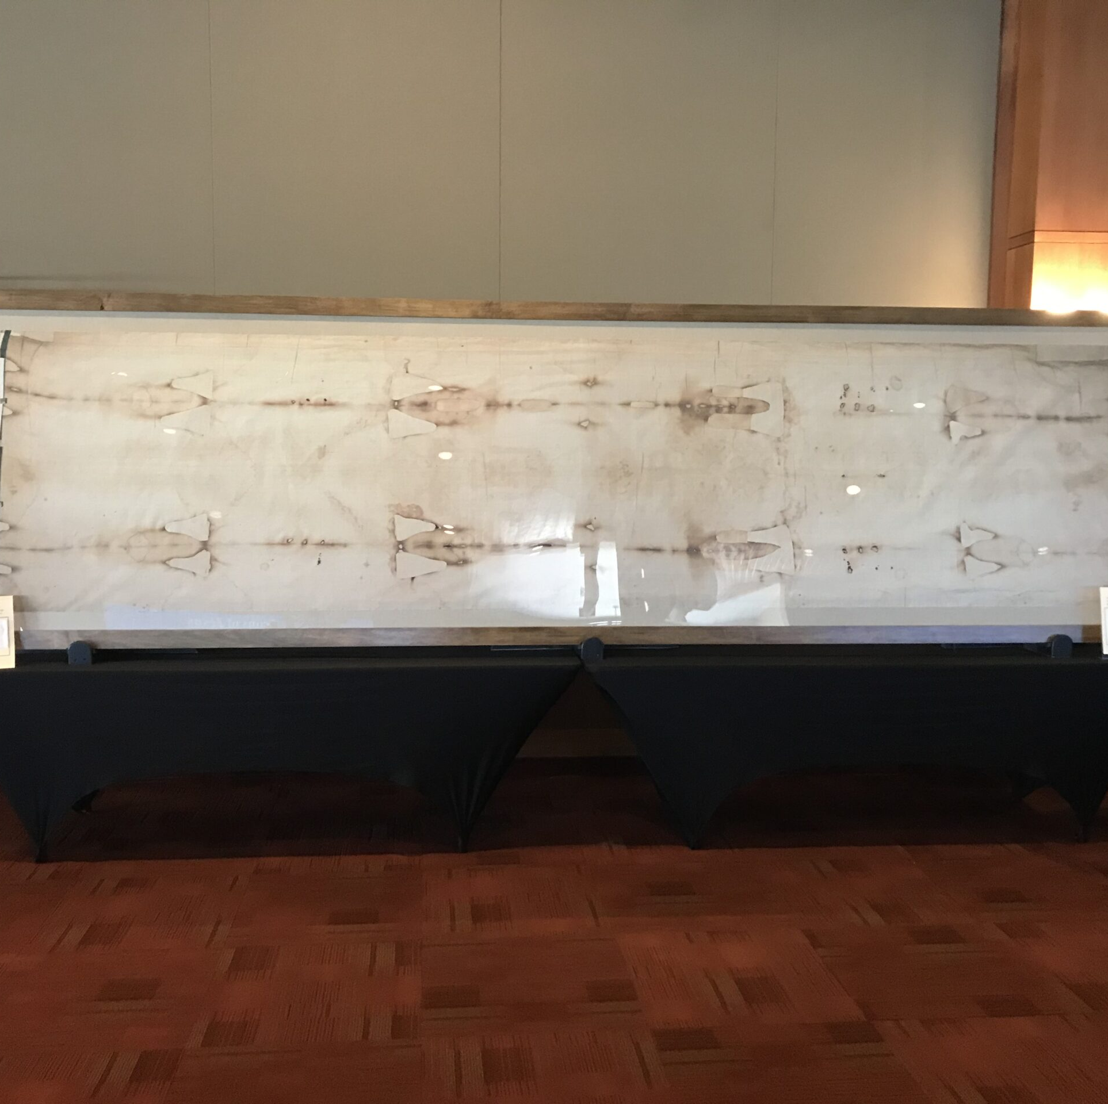
You helped make the framing possible and left a legacy of strength, faith and hope

Slide 11
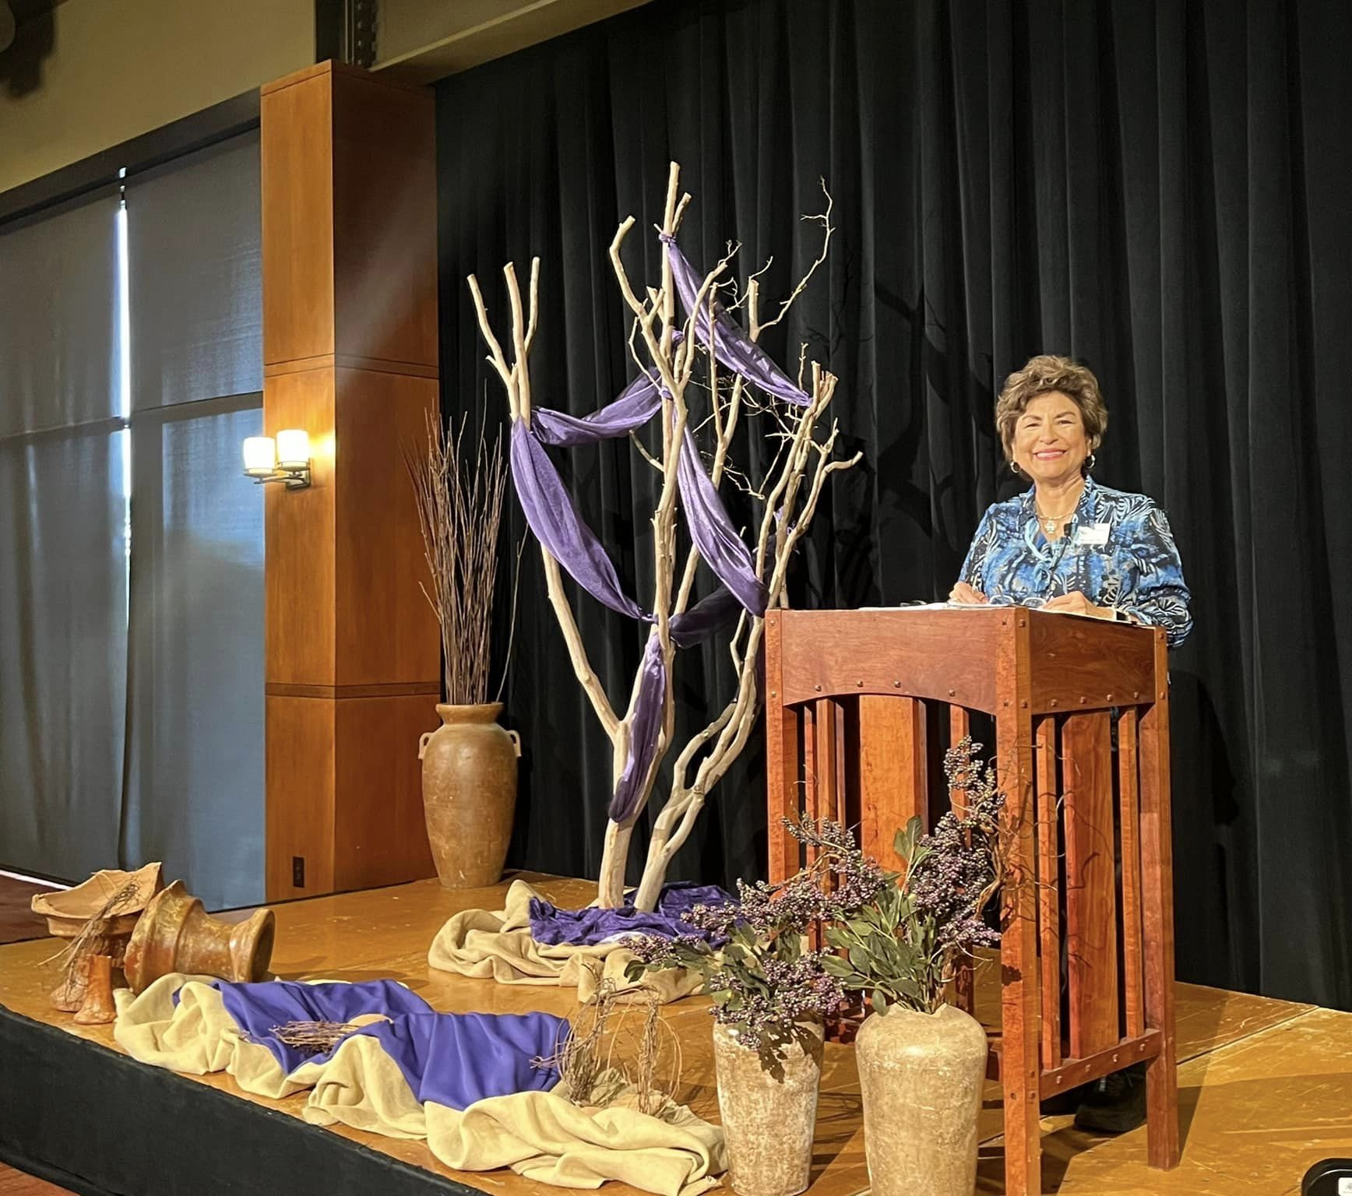
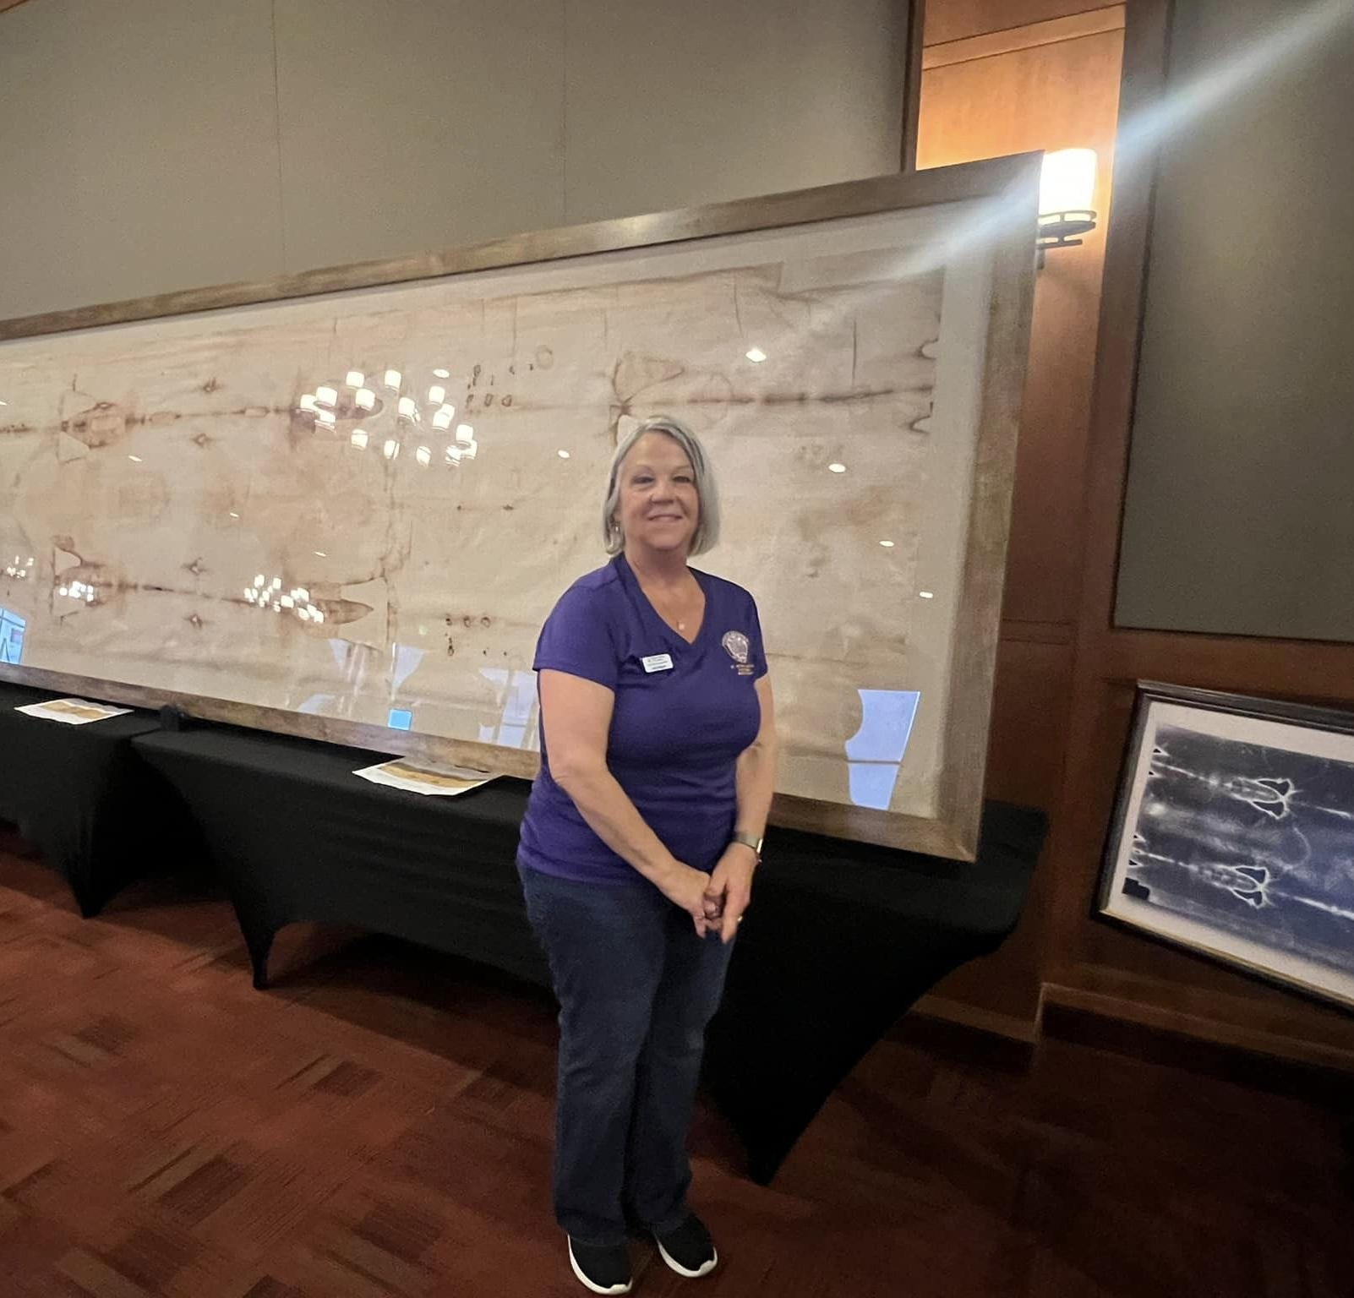

Slide 12
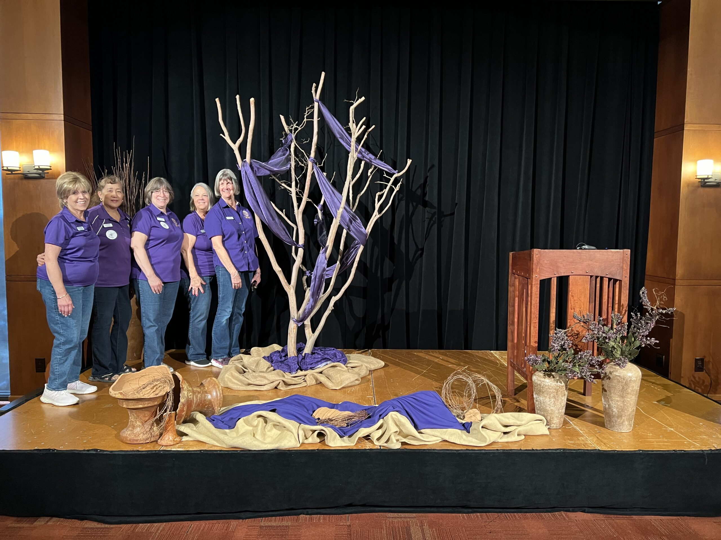

Slide 13
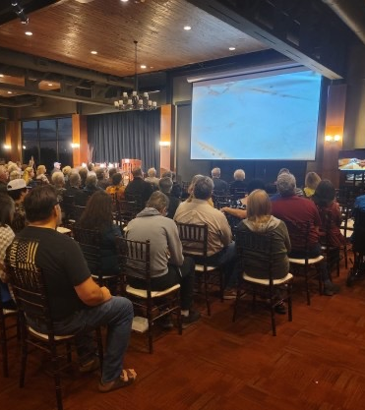
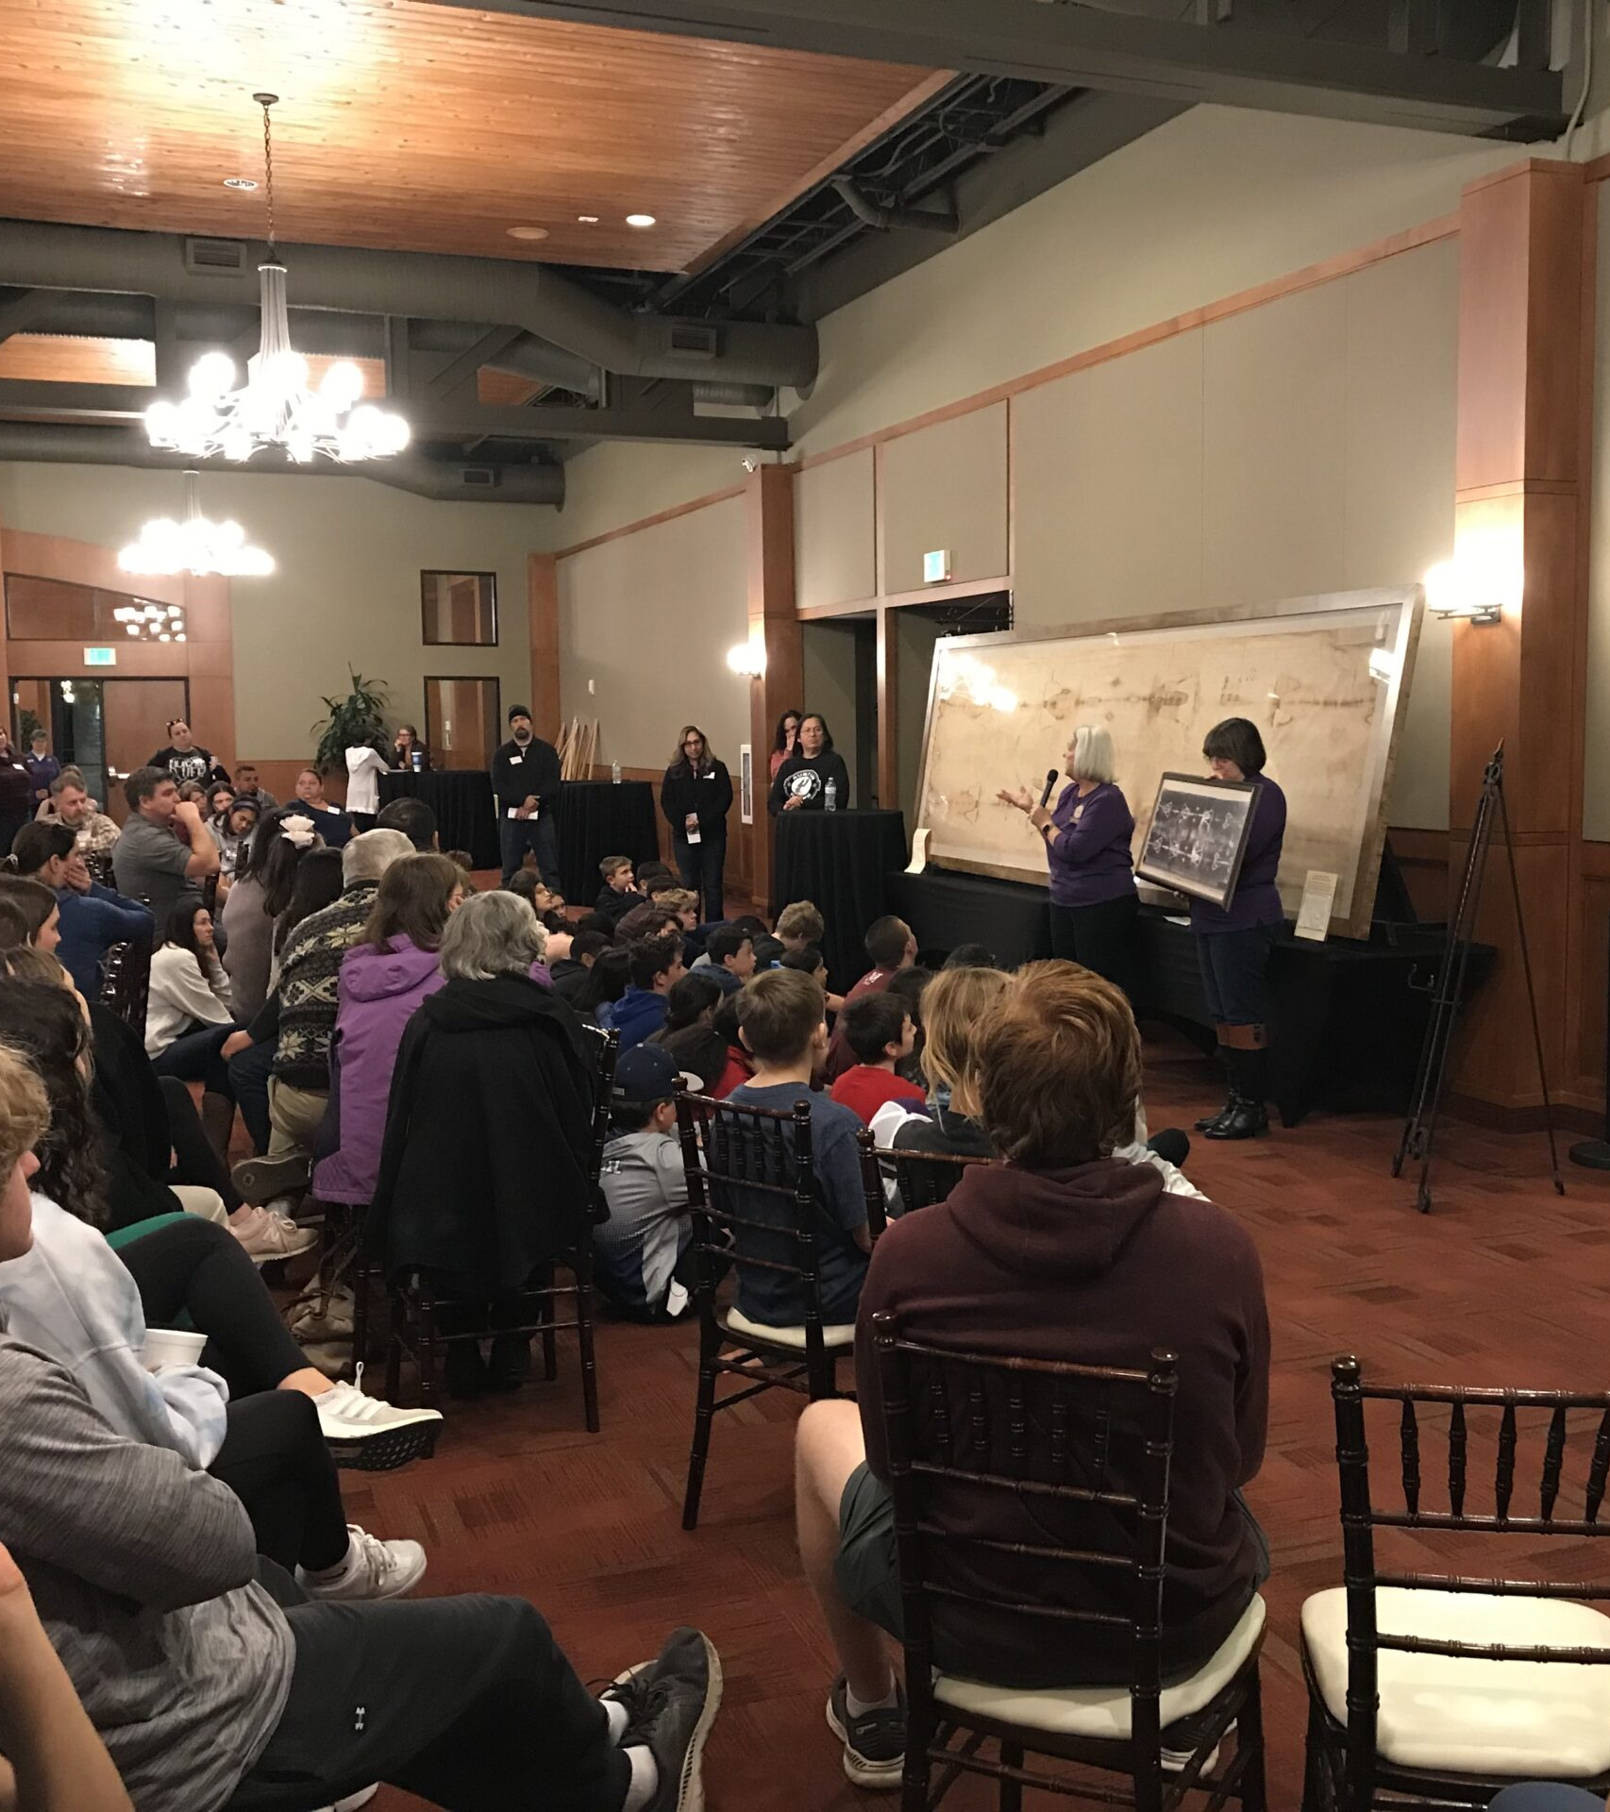
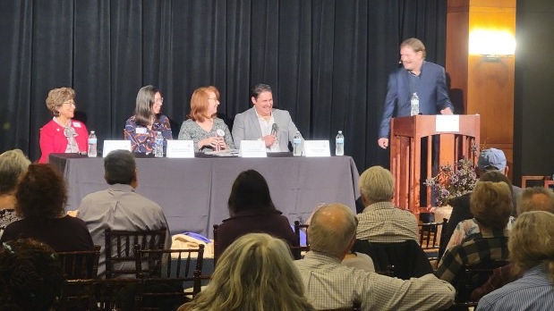
The Shroud
Over 1,000 people came and you loved them

Slide 14
Youth/JCDA
Category V - 126+ Members
1st Place
Day 1 Bags

Slide 15
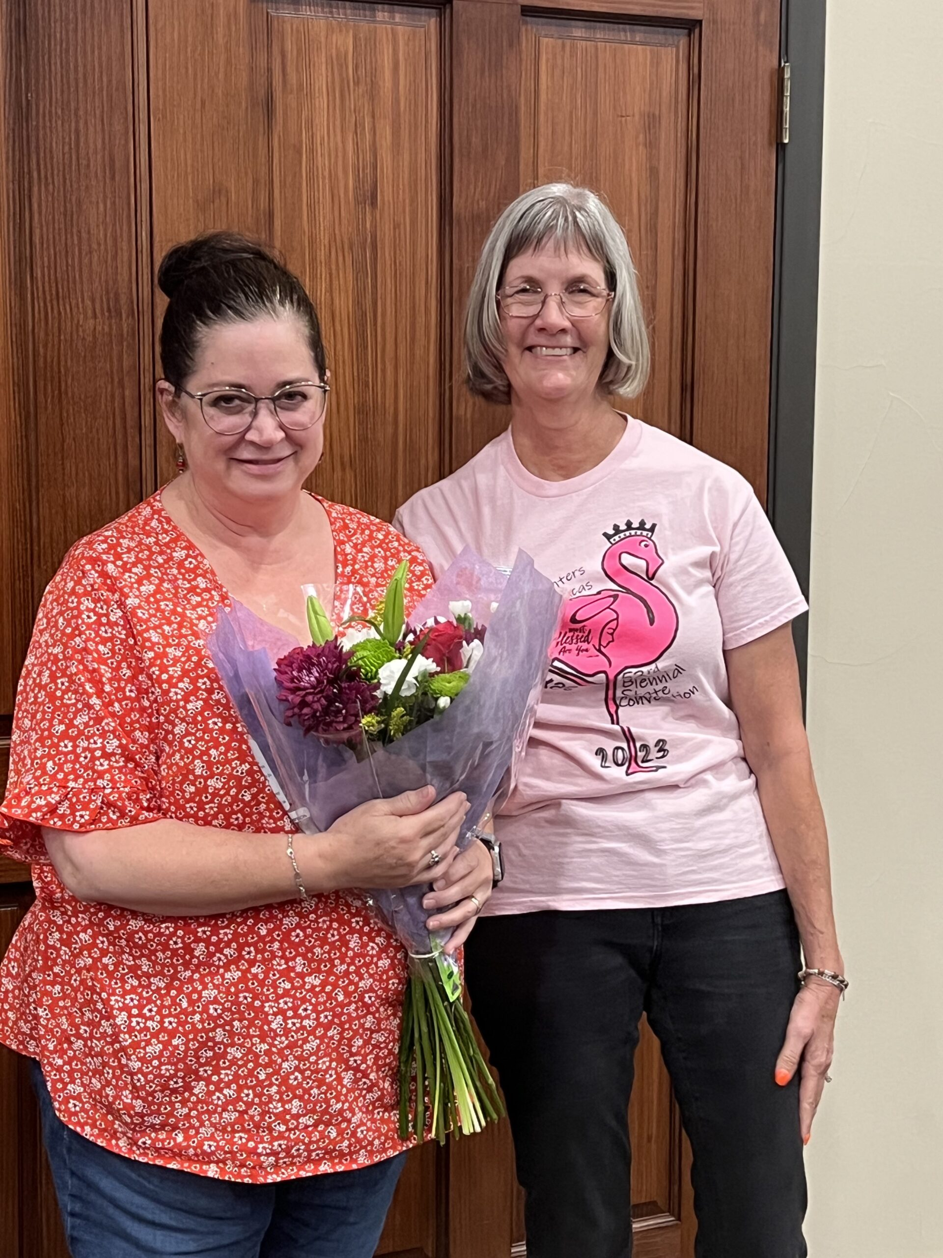
And Newsletter Contest
Category V - Division II
1st Place - AGAIN
Donna Oates, Editor

Slide 16
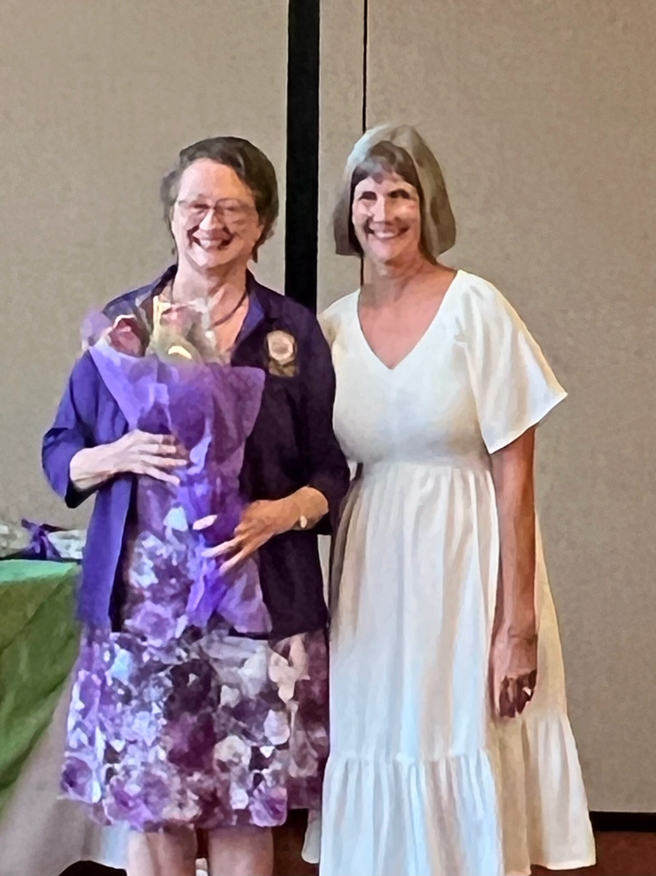
2024
Congratulations to all who contributed – you are what makes this court so outstanding!
Special thanks to Barbara Vogt for pulling all the reports together to make this recognition a reality.
AND……

Slide 17
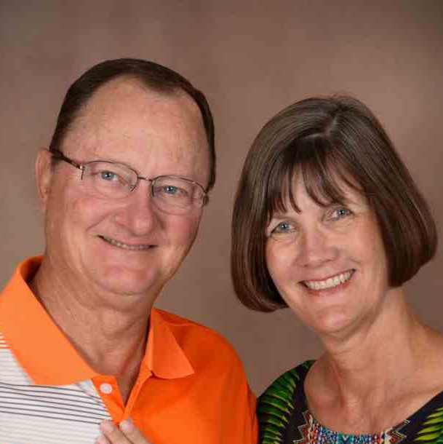
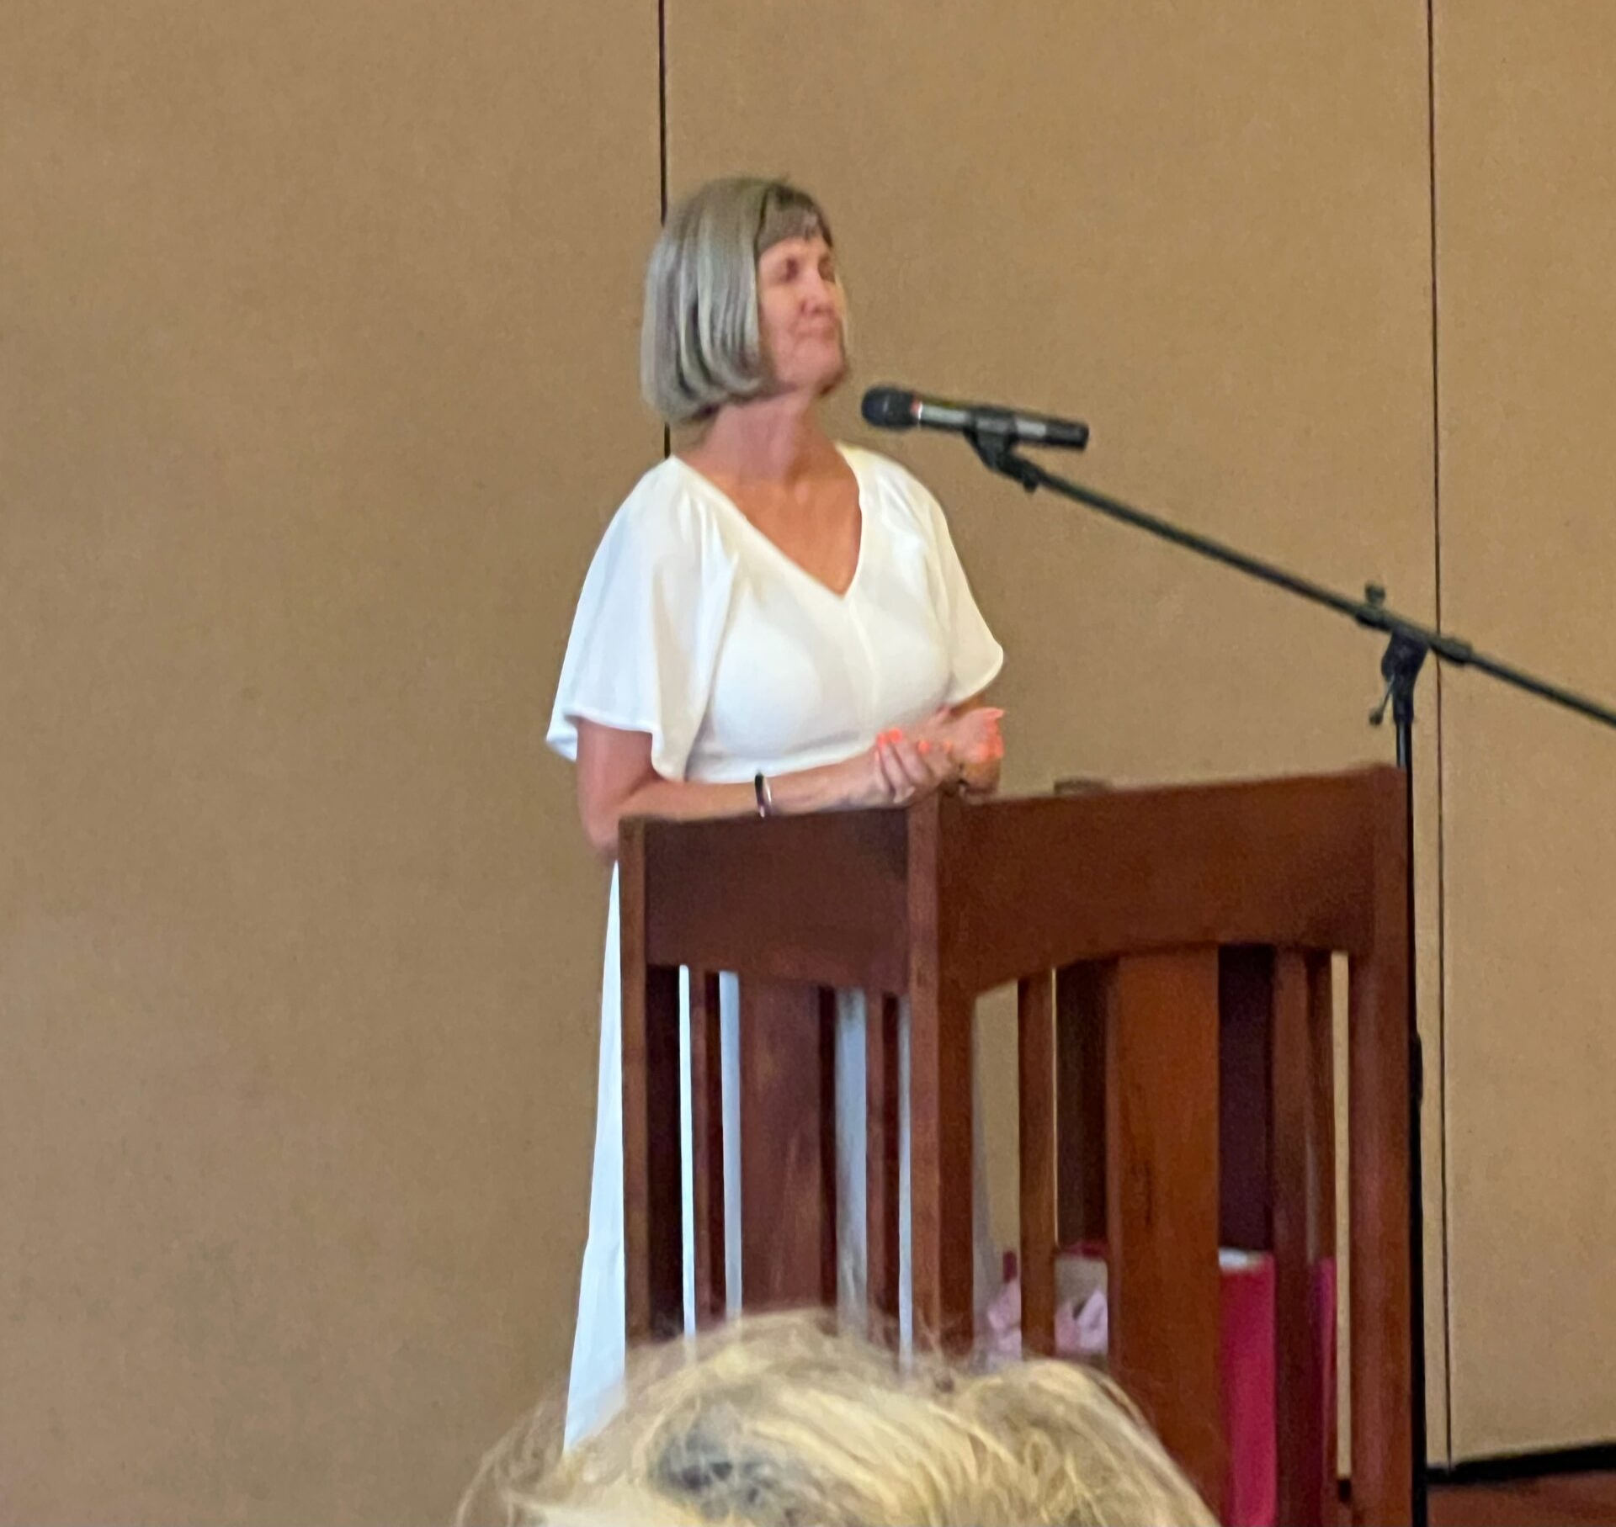
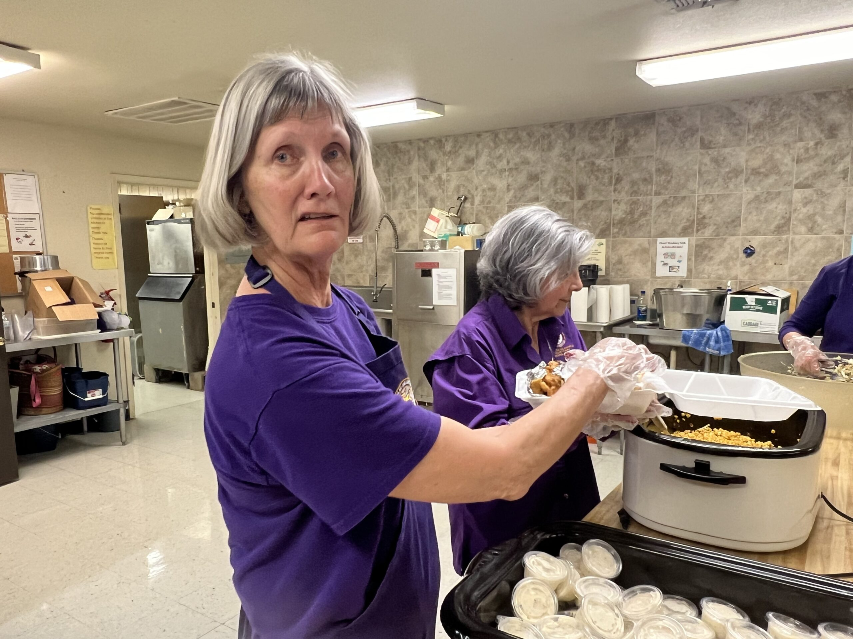
2024
The outstanding leadership of
Dorothy Meuth,
Our loved Past Regent
And support of her husband Tommy
Thank you both!

